Slide 1
Low-Resource ASR
with Fine-Tuning of
Pretrained Models
2025 Automated Speech Recognition
Adrianna Paszkowska, Hyunjoo Cho,
Mohamed Khattab, Younghee Jeong

Slide 2
INTRODUCTION
We developed a speech recognition system for a low-resource language using transfer learning
We fine-tuned a pretrained multilingual model (wav2vec 2.0 XLS-R) on a small, publicly available dataset from Common Voice and
explore the effectiveness of pretrained model for 1h and ~138h of training

Slide 3
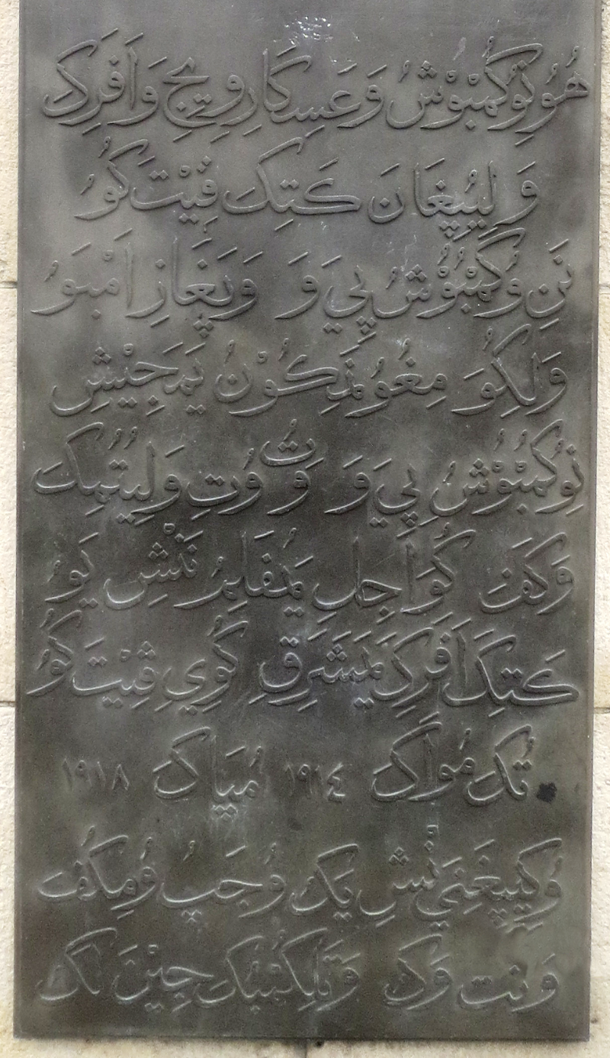
SWAHILI
Bantu Language of Sabaki branch [1]
Word “Swahili” comes from Arabic name means “coasts” [2]
Most of its loanwords come from arabic where it’s spoken [1]
Notes:
[1]https://yourhistoryisnotlost.home.blog/2019/04/24/swahili/
[2]https://www.dictionary.com/browse/swahili
[picture]https://commons.wikimedia.org/wiki/File:Askari_makumbusho_matini_Kiswahili_-_Kiarabu.png

Slide 4
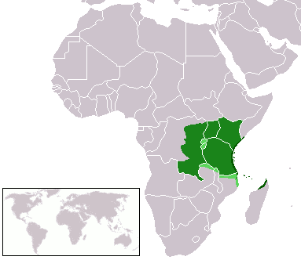
SWAHILI
Mainly spoken in Tanzania, Kenya, and Mozambique[10]
Also spoken in Burundi, Comoros, Malawi, and Zambia by a small number of people[9]
A second language spoken by tens of millions of people in the five African Great lakes countries [11]
Spoken by around 100 million people[10]
Notes:
Dark grean = swahili majority
light green = swahili minority
[1]https://www.jstor.org/stable/j.ctt1qv5pgq
[2]https://clp.arizona.edu/courses/languages/swahili
[3]https://www.worlddata.info/languages/swahili.php

Slide 5
BACKGROUND
People who speak swahili are called Waswahili [5]
Tanzania uses swahili for as a language of administration and primary education [6]
Its used similarly in Kenya, Congo and Uganda which use it as an administrative language [6]
Many language technology applications have been developed
Spelling checker[3]
POS tagging[4]
Electronic dictionary[4]
Machine translation[4]
Notes:
[1]https://www.microsoft.com/sw-ke/download/details.aspx?id=52668
[2]http://77.240.23.241/
[3]https://www.jstor.org/stable/1158841
[4]https://www.britannica.com/topic/Swahili-language

Slide 6
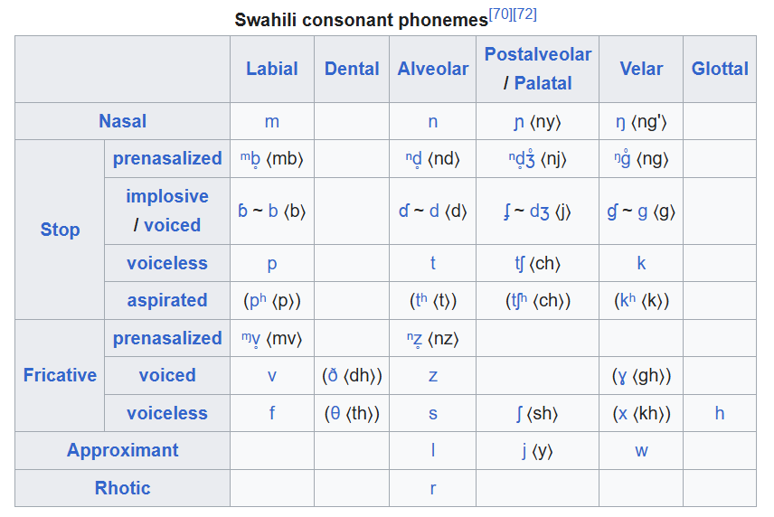
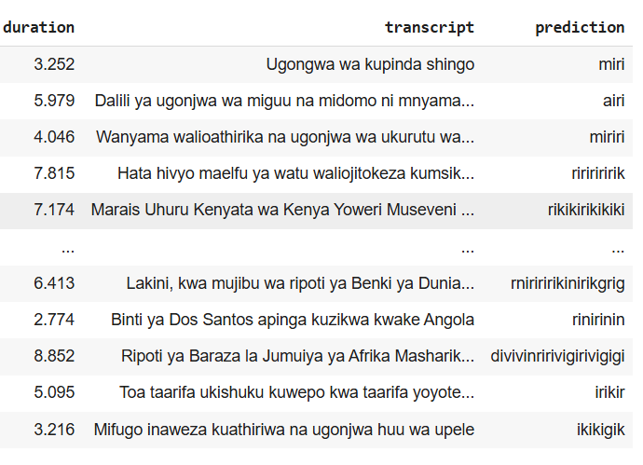
Swahili comparison
Model used is multilingual, but Swahili has some differences from more common training languages
phonemes inventory: 5 vowel and approximately 33 consonants
Special sounds and features: dh, gh, ng', gw, sh, and th.
if phoneme is less likely to appear, the model is substituting for the closest sound

Slide 7
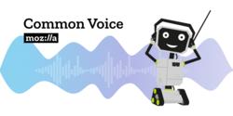
COMMON VOICE
Total 137 languages [12]
33,816 recorded hours [12]
Dataset consists of a unique MP3 and corresponding text file [12]
Free and open speech corpus [12]
Notes:
[1]https://commonvoice.mozilla.org/en/datasets
So to start with the project, we used Common voice to gather the data recordings we need.
Including our target data, they have 137 different languages which have in total around 34 thousand recorded hours.
Datasets are consisting unique MP3 and corresponding text files
And al dataset are free and open speech corpus

Slide 8
SWAHILI DATASET
Total 28 dataset[1]
Collection started from the beginning of 2022[1]
Age and gender is collected alongside the data, but some of the data are not recorded or missing[1]
Notes:
[1]https://commonvoice.mozilla.org/en/datasets
For our Swahili dataset, we had total 28 different datasets we can download from.
The collection started since the beginning of 2022, and age and gender were collected alongside the data. However, some of the data did not have fulfilled information.

Slide 9
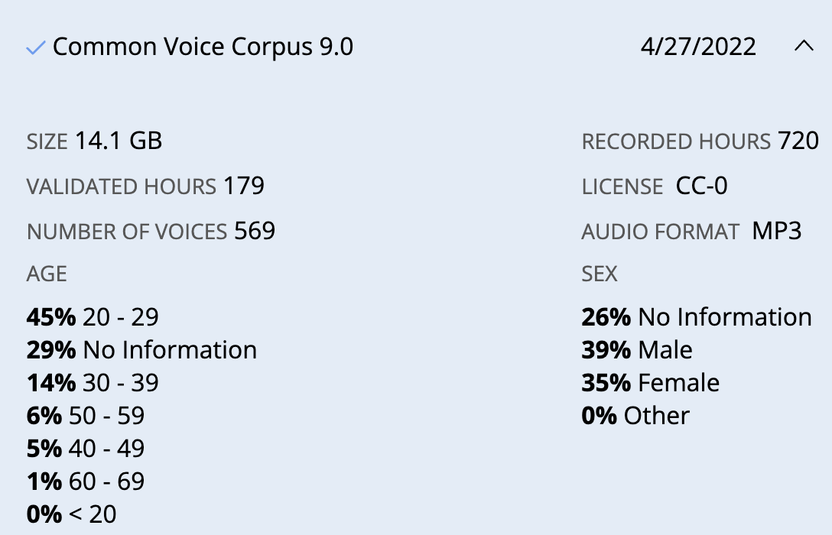
USED SWAHILI DATASET
Notes:
In total, we used three different dataset.
First one was Common voice corpus 9.0 which was collected on the 27th of April in 2022.
This had the size of 14.1gb, which had full recorded hours as 720.

Slide 10
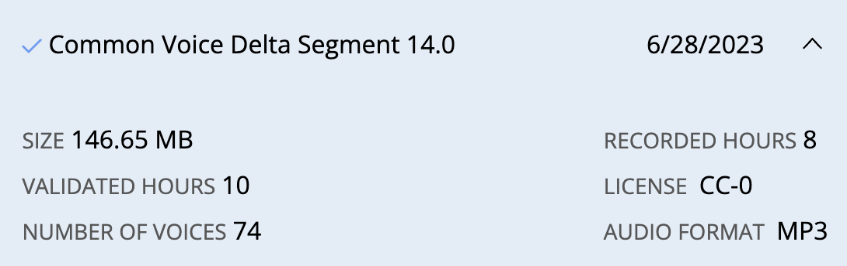
USED SWAHILI DATASET

Slide 11
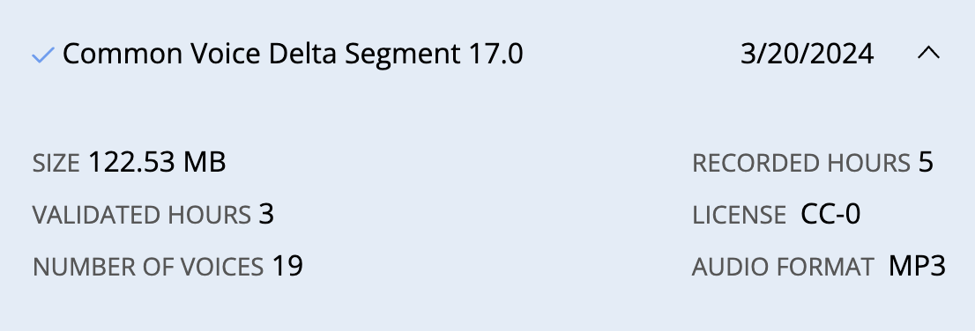
USED SWAHILI DATASET

Slide 12
PREPROCESSING: from Common Voice
Extracted necessary components only such as transcriptions and audio paths
Used pydub to clean and standardise clips by splitting on silence with threshold of -40 db and minimum silence length of 150ms
We cut clips shorter than 200 ms
Converted all audio files to WAV format, 16khz sampling rate and mono channel

Slide 13
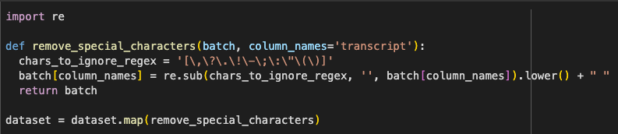
PREPROCESSING :Remove special token
Step 1:
Removes special characters from the transcript column using regex, converts text to lowercase, and adds a trailing space. It helps normalize transcripts for ASR training
Notes:
We believe that special character normalization may no longer be necessary when integrating with a language model in future work

Slide 14
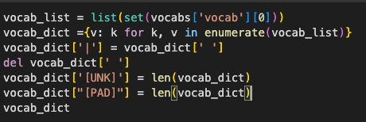
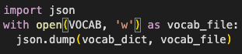
PREPROCESSING: Save vocab.json
Step 2:
Builds a vocabulary dictionary from the unique characters in the dataset. Adds special tokens like [UNK] and [PAD] for unknown and padding purposes. Saves the vocabulary dictionary to a JSON file for later use by the tokenizer.

Slide 15
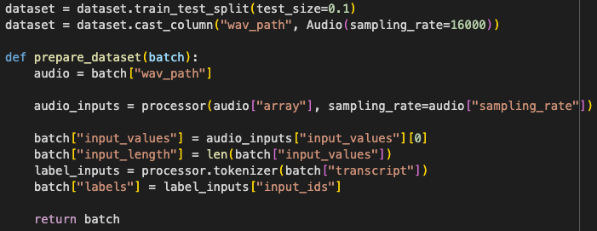
PREPROCESSING: Convert to input form
Step 3:
Splits the dataset and converts audio paths into waveform arrays at 16kHz.
Then, it extracts input features and tokenized labels for each sample, storing them in a training-ready format.
Notes:
We extract both the model input values and the transcript label IDs here, so each sample becomes a tuple of (audio, audio_length ,label) for training.

Slide 16
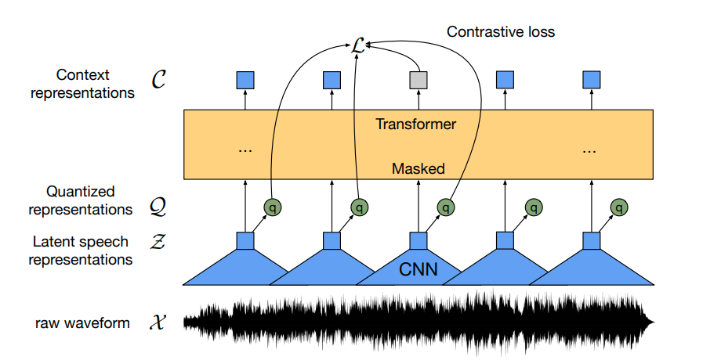
What is Wav2Vec 2.0 XLSR?
Wav2Vec 2.0 is a self-supervised model for learning speech representations from raw audio.
XLSR is a multilingual variant of Wav2Vec 2.0, trained on speech data from over 50 languages to enable cross-lingual representation learning
It uses a CNN encoder to extract latent features, then applies masking and a Transformer to learn context.
Quantized targets are predicted using contrastive loss, enabling effective pre-training without labels.
These trained representations can be fine-tuned for ASR and other speech tasks.
Notes:
Wav2Vec 2.0 is a self-supervised model for learning speech representations from raw audio and XLSR is a multilingual variant of Wav2Vec 2.0, which is trained on speech data from over 50 languages to enable cross-lingual representation learning.

Slide 17







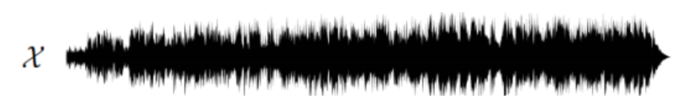

How is it pretrained?: Feature Encoder <f: X->Z>

Slide 18
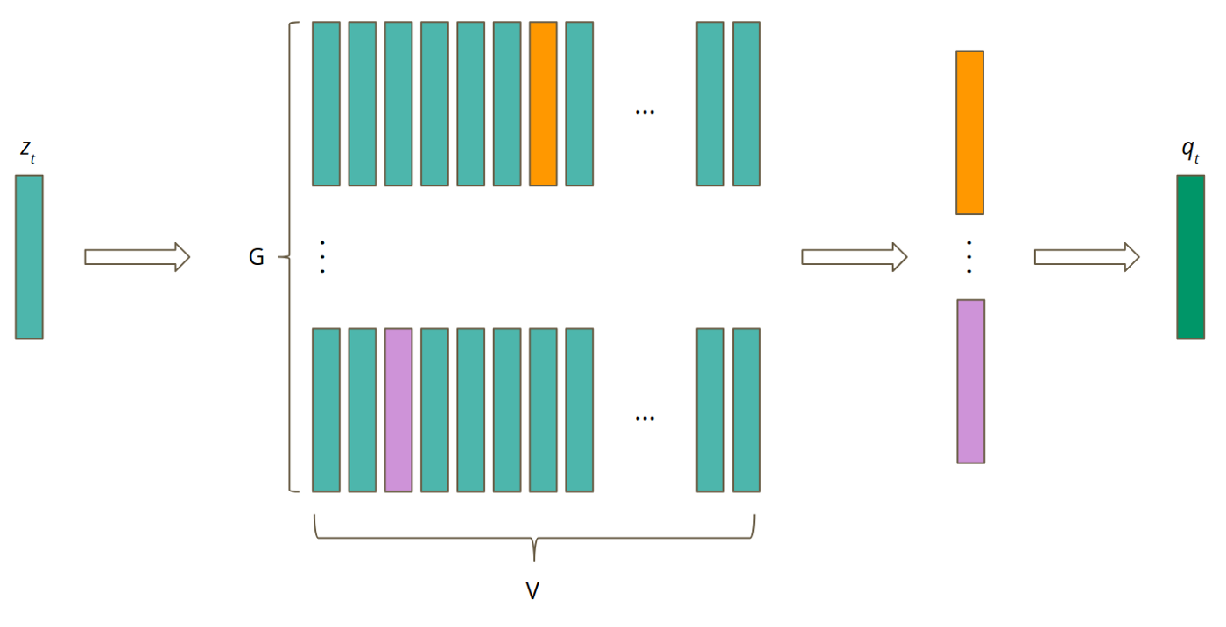
How is it pretrained?: Quantization Module <Z->Q>

Slide 19

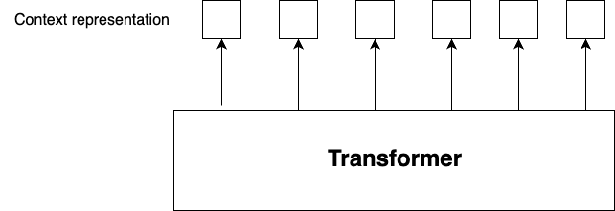
How is it pretrained?: Transformer Module <g: Z->C>
Contrastive loss
Z_t: latent speech vector for each time step

Slide 20
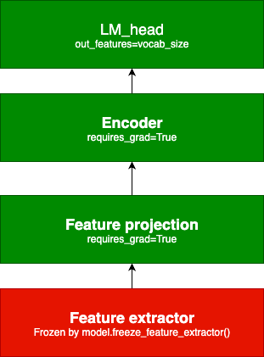
How is Wav2Vec 2.0-XLSR fine-tuned for ASR?
Output: weka safuria yako jikoni
CTC Loss
Linear layer
(1024, 52)
Feature projection layer
Adapted from Baevski et al.(2020)
Notes:
The linear layer, or LM head, maps the encoder’s high-dimensional context representations to vocabulary logits at each time step.
This enables the model to predict characters or subword tokens for speech recognition.

Slide 21
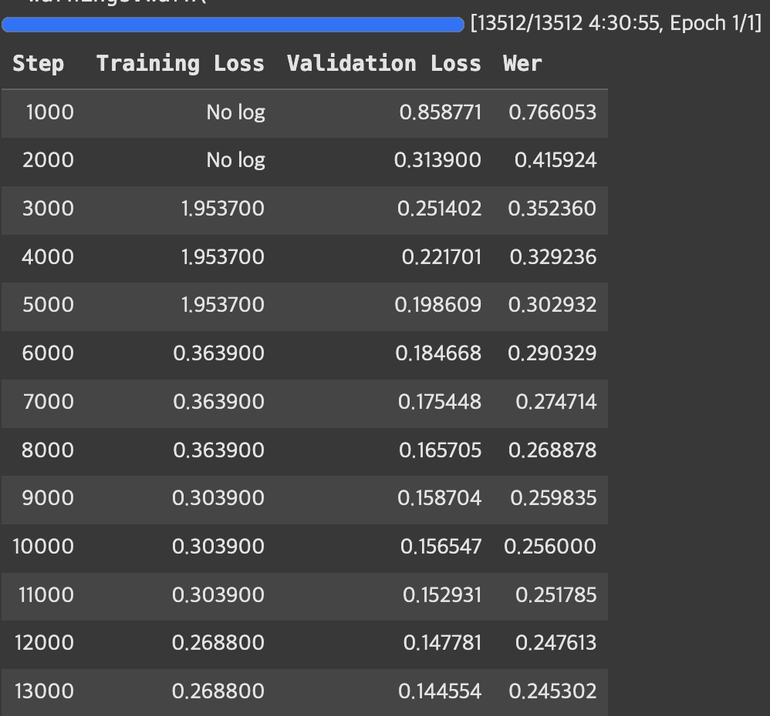
METHODS
Baseline run
100% WER
1h
100% WER
138h
24% WER

Slide 22
TRAINING SETUP: Training arguments
config=model.config
config.ctc_loss_reduction = "mean"
config.pad_token_id = processor.tokenizer.pad_token_id
config.vocab_size = vocab_size
TrainingArguments(
per_device_train_batch_size=8,
eval_strategy="steps",
num_train_epochs=1,
fp16=True,
learning_rate=1e-4,
weight_decay=0.005,
warmup_steps=1000
.
.
.
)

Slide 23
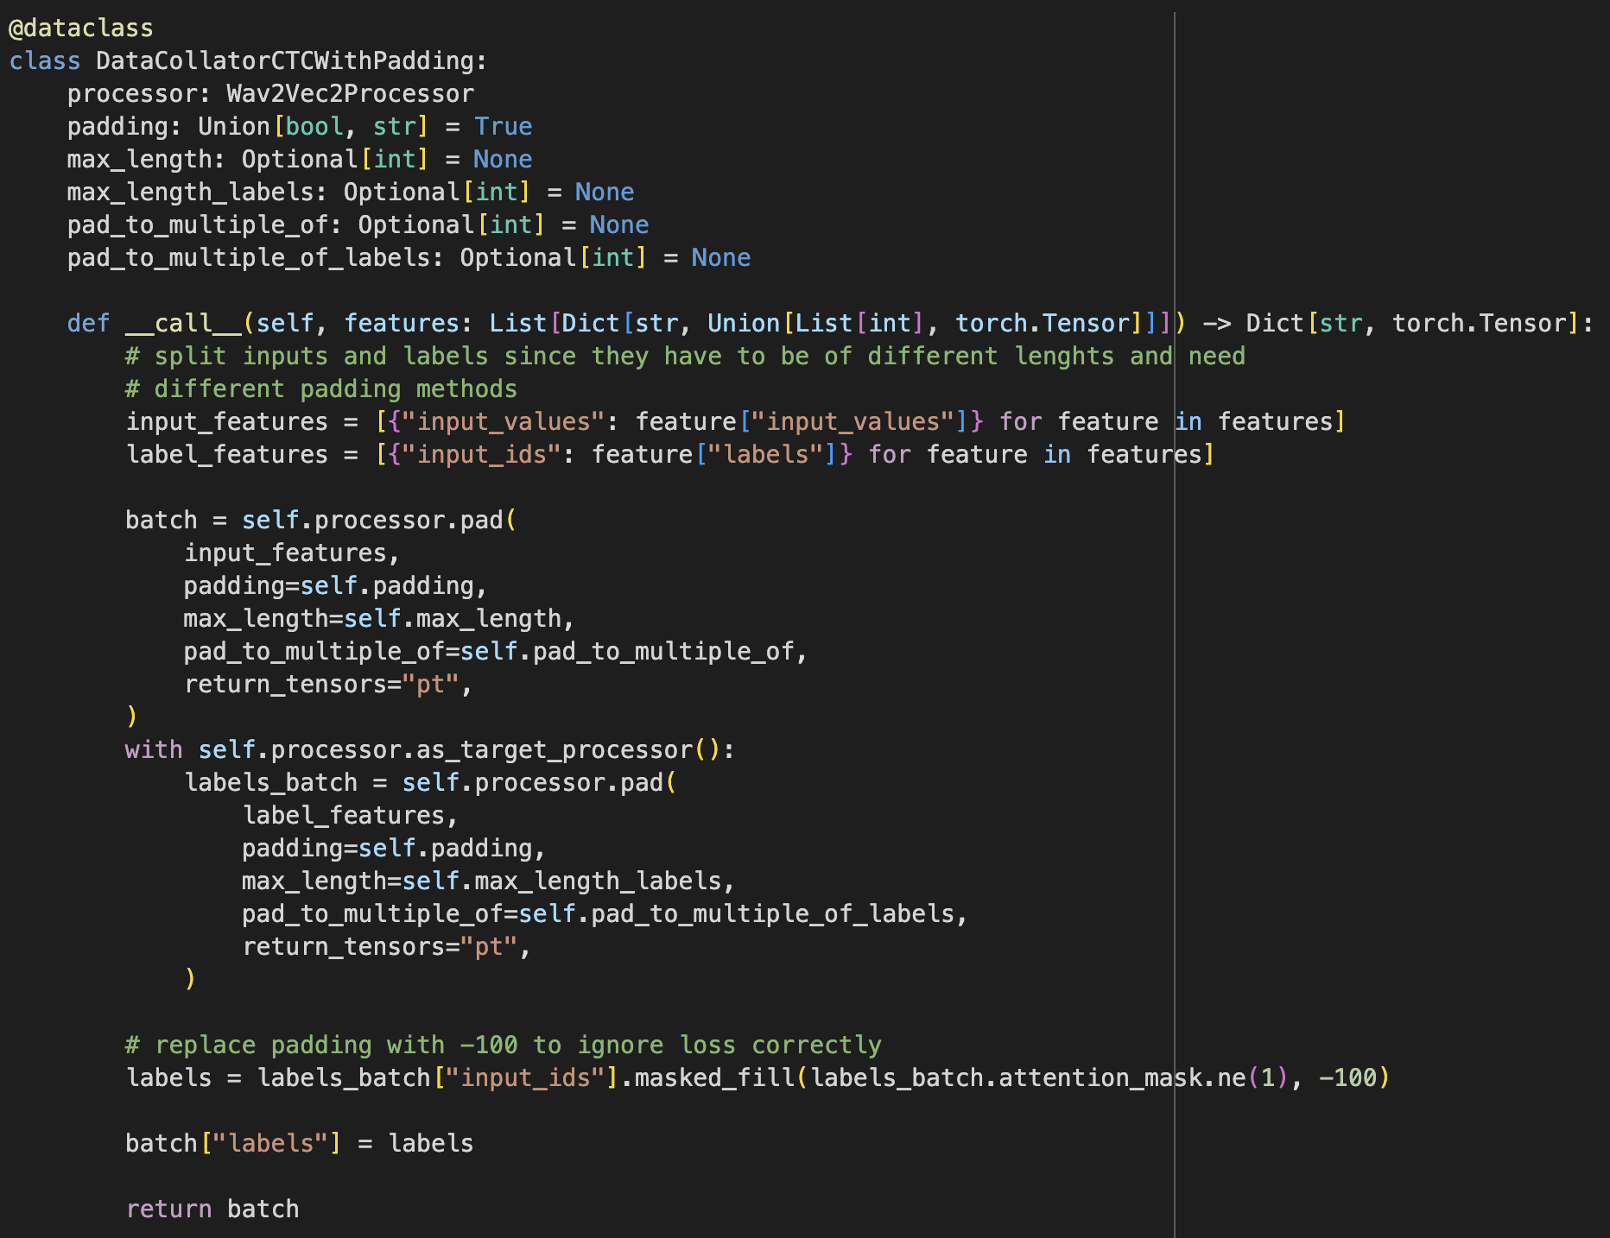
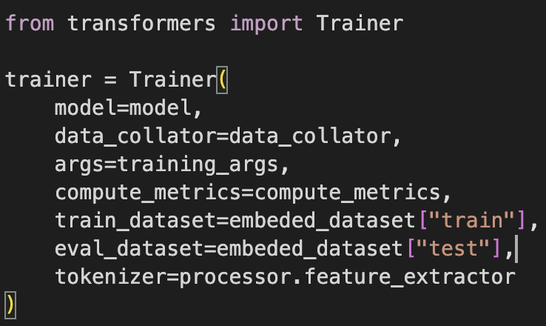
TRAINING SETUP: Data collator

Slide 24
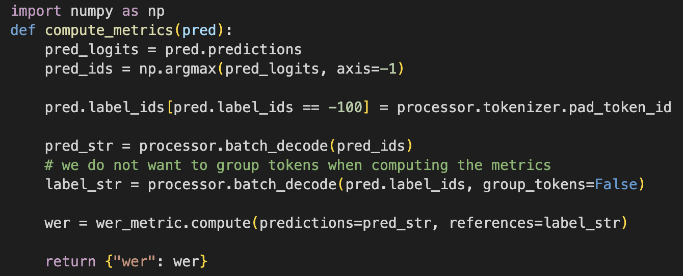
TRAINING SETUP: Compute Metrics

Slide 25
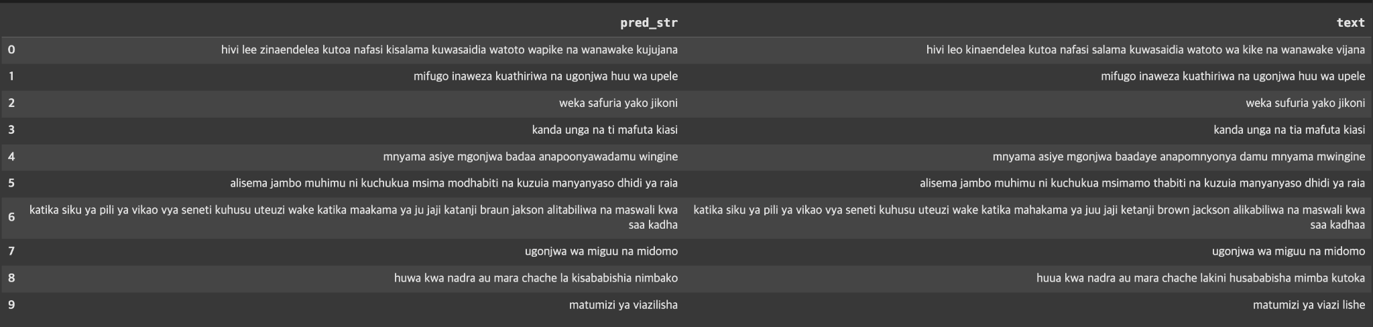
EXPERIMENTAL RESULTS

Slide 26
EVALUATION
In comparison to available pre-trained Swahili models:
 | Our model | Adeptschneider/wav2vec-large-swahili-asr-model-with-swahili-language-model | thinkKenya/wav2vec2-large-xls-r-300m-sw
WER | 0.2453 | 0.1481 | 0.2602
Loss | 0.1446 | 0.3257 | 0.3454

Slide 27
CHALLENGES AND LIMITATIONS
GPU
We didn’t have resources to experiment with learning parameters more
Memory
Speech data takes is relatively big compared to text
Feature extractor couldn’t be trained

Slide 28
FURTHER PLAN
Lower WER?
Optional experiments
Language Modeling
See if training model with feature vector after encoder will improve performance
Augmentation:
Possible way to obtain more data would be to artificially increase available datasets, modifying the speed and pitch or adding noise
Pseudo-labeling:
Use different model to generate labels and use them for training, i.e. Whisper

Slide 29
CONCLUSION
We managed to fine-tune pre-trained model for low-resource language with some accuracy
The WER started to improve after of training
We achieved final WER 24% after training on 138h of data
The full model was pushed on: https://huggingface.co/jkhyjkhy/wav2vec2-large-xlsr-sw-ASR

Slide 30
REFERENCES
[1] https://yourhistoryisnotlost.home.blog/2019/04/24/swahili/
[2] https://www.dictionary.com/browse/swahili
[3] https://www.microsoft.com/sw-ke/download/details.aspx?id=52668
[4] http://77.240.23.241/
[5] https://www.jstor.org/stable/1158841
[6] https://www.britannica.com/topic/Swahili-language
[7] https://huggingface.co/docs/transformers/en/tasks/asr#train
[8] Baevski, A., Zhou, Y., Mohamed, A., & Auli, M. (2020). wav2vec 2.0: A framework for self-supervised learning of speech representations. Advances in neural information processing systems, 33, 12449-12460.
[9] https://www.jstor.org/stable/j.ctt1qv5pgq
[10 ]https://clp.arizona.edu/courses/languages/swahili
[11] https://www.worlddata.info/languages/swahili.php
[12] https://commonvoice.mozilla.org/en/datasets

Slide 31
Thanks a lot, and any questions?
?

